Slide 1
Chapter 5.2
Introduction to the C Language

Slide 2
Introduction of C
C is a structured programming language. It is considered a high-level language because it allows the programmer to concentrate on the problem at hand and not worry about the machine that the program will be using. That is another reason why it is used by software developers whose applications have to run on many different hardware platforms.
Notes:
Developed early 1970’s

Slide 3
Features of C
Simple and Efficient
Fast
Portability
Extensibility
Function-Rich Libraries
Dynamic Memory Management
Modularity With Structured Language
Mid-Level Programming Language
Pointers
Recursion
Notes:
Simple and Efficient
The basic syntax style of implementing C language is very simple and easy to learn. This makes the language easily comprehensible and enables a programmer to redesign or create a new application. C is usually used as an introductory language to introduce programming to school students because of this feature.
Fast
It is a well-known fact that statically typed programming languages are faster than dynamic ones. C is a statically typed programming language, which gives it an edge over other dynamic languages. Also, unlike Java and Python, which are interpreter-based, C is a compiler-based program. This makes the compilation and execution of codes faster.
Another factor that makes C fast is the availability of only the essential and required features. Newer programming languages come with numerous features, which increase functionality but reduce efficiency and speed. Since C offers limited but essential features, the headache of processing these features reduces, resulting in increased speed.
Portability
Another feature of the C language is portability. To put it simply, C programs are machine-independent which means that you can run the fraction of a code created in C on various machines with none or some machine-specific changes. Hence, it provides the functionality of using a single code on multiple systems depending on the requirement.
Extensibility
You can easily (and quickly) extend a C program. This means that if a code is already written, you can add new features to it with a few alterations. Basically, it allows adding new features, functionalities, and operations to an existing C program.
Function-Rich Libraries
C comes with an extensive set of libraries with several built-in functions that make the life of a programmer easy. Even a beginner can easily code using these built-in functions. You can also create your user-defined functions and add them to C libraries. The availability of such a vast scope of functions and operations allows a programmer to build a vast array of programs and applications.
Dynamic Memory Management
One of the most significant features of C language is its support for dynamic memory management (DMA). It means that you can utilize and manage the size of the data structure in C during runtime. C also provides several predefined functions to work with memory allocation. For instance, you can use the free() function to free up the allocated memory at any time. Similarly, there are other functions such as malloc(), calloc(), and realloc() to perform operations on data structure and memory allocations.
Modularity With Structured Language
C is a general-purpose structured language. This feature of C language allows you to break a code into different parts using functions which can be stored in the form of libraries for future use and reusability.. Structuring the code using functions increases the visual appeal and makes the program more organized and less prone to errors.
Mid-Level Programming Language
Although C was initially developed to do only low-level programming, it now also supports the features and functionalities of high-level programming, making it a mid-level language. And as a mid-level programming language, it provides the best of both worlds. For instance, C allows direct manipulation of hardware, which high-level programming languages do not offer.
Pointers
With the use of pointers in C, you can directly interact with memory. As the name suggests, pointers point to a specific location in the memory and interact directly with it. Using the C pointers, you can operate with memory, arrays, functions, and structures.
Recursion
C language provides the feature of recursion. Recursion means that you can create a function that can call itself multiple times until a given condition is true, just like the loops. Recursion in C programming provides the functionality of code reusability and backtracking.

Slide 4
FIGURE 2-2 Structure of a C Program

Slide 5
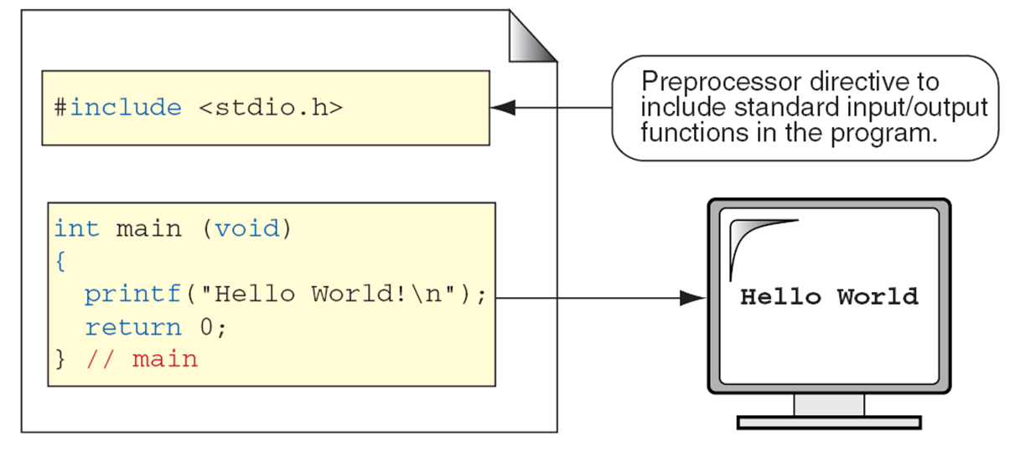
C Preprocessor and Header Files
A header file is a file containing C declarations and macro definitions to be shared between several source files. You request the use of a header file in your program by including it, with the C preprocessing directive ‘#include’.

Slide 6
2-2 C Programs
It's time to write your first C program.
Topics discussed in this section:
Structure of a C Program
Your First C Program
Comments
The Greeting Program

Slide 7

FIGURE 2-3 The Greeting Program

Slide 8
PROGRAM 2-1
The Greeting Program

Slide 9
FIGURE 2-4 Examples of Block Comments

Slide 10
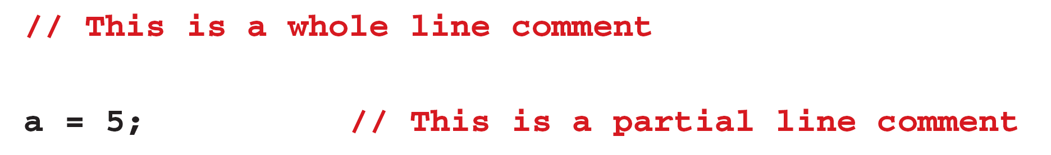
FIGURE 2-5 Examples of Line Comments

Slide 11
Character set
Type of Character | Description | Characters
Lowercase Alphabets | a to z | a, b, c, d, e, f, g, h, i, j, k, l, m, n, o, p, q, r, s, t, u, v, w, x, y, z
Uppercase Alphabets | A to Z | A, B, C, D, E, F, G, H, I, J, K, L, M, N, O, P, Q, R, S, T, U, V, W, X, Y, Z
Digits | 0 to 9 | 0, 1, 2, 3, 4, 5, 6, 7, 8, 9
Special Characters | – | ` ~ @ ! $ # ^ * % & ( ) [ ] { } < > + = _ – | / \ ; : ‘ “ , . ?
White Spaces | – | Blank Spaces, Carriage Return, Tab, New Line
Notes:
Simple and Efficient
The basic syntax style of implementing C language is very simple and easy to learn. This makes the language easily comprehensible and enables a programmer to redesign or create a new application. C is usually used as an introductory language to introduce programming to school students because of this feature.
Fast
It is a well-known fact that statically typed programming languages are faster than dynamic ones. C is a statically typed programming language, which gives it an edge over other dynamic languages. Also, unlike Java and Python, which are interpreter-based, C is a compiler-based program. This makes the compilation and execution of codes faster.
Another factor that makes C fast is the availability of only the essential and required features. Newer programming languages come with numerous features, which increase functionality but reduce efficiency and speed. Since C offers limited but essential features, the headache of processing these features reduces, resulting in increased speed.
Portability
Another feature of the C language is portability. To put it simply, C programs are machine-independent which means that you can run the fraction of a code created in C on various machines with none or some machine-specific changes. Hence, it provides the functionality of using a single code on multiple systems depending on the requirement.
Extensibility
You can easily (and quickly) extend a C program. This means that if a code is already written, you can add new features to it with a few alterations. Basically, it allows adding new features, functionalities, and operations to an existing C program.
Function-Rich Libraries
C comes with an extensive set of libraries with several built-in functions that make the life of a programmer easy. Even a beginner can easily code using these built-in functions. You can also create your user-defined functions and add them to C libraries. The availability of such a vast scope of functions and operations allows a programmer to build a vast array of programs and applications.
Dynamic Memory Management
One of the most significant features of C language is its support for dynamic memory management (DMA). It means that you can utilize and manage the size of the data structure in C during runtime. C also provides several predefined functions to work with memory allocation. For instance, you can use the free() function to free up the allocated memory at any time. Similarly, there are other functions such as malloc(), calloc(), and realloc() to perform operations on data structure and memory allocations.
Modularity With Structured Language
C is a general-purpose structured language. This feature of C language allows you to break a code into different parts using functions which can be stored in the form of libraries for future use and reusability.. Structuring the code using functions increases the visual appeal and makes the program more organized and less prone to errors.
Mid-Level Programming Language
Although C was initially developed to do only low-level programming, it now also supports the features and functionalities of high-level programming, making it a mid-level language. And as a mid-level programming language, it provides the best of both worlds. For instance, C allows direct manipulation of hardware, which high-level programming languages do not offer.
Pointers
With the use of pointers in C, you can directly interact with memory. As the name suggests, pointers point to a specific location in the memory and interact directly with it. Using the C pointers, you can operate with memory, arrays, functions, and structures.
Recursion
C language provides the feature of recursion. Recursion means that you can create a function that can call itself multiple times until a given condition is true, just like the loops. Recursion in C programming provides the functionality of code reusability and backtracking.

Slide 12
2-3 Identifiers
One feature present in all computer languages is the identifier. Identifiers allow us to name data and other objects in the program. Each identified object in the computer is stored at a unique address.

Slide 13
Table 2-1
Rules for Identifiers

Slide 14
Note
An identifier must start with a letter or underscore: it may not have a space or a hyphen.

Slide 15
Note
C is a case-sensitive language.

Slide 16
Table 2-2
Examples of Valid and Invalid Names

Slide 17
2-4 Types
A type defines a set of values and a set of operations that can be applied on those values.
Topics discussed in this section:
Void Type
Integral Type
Floating-Point Types

Slide 18
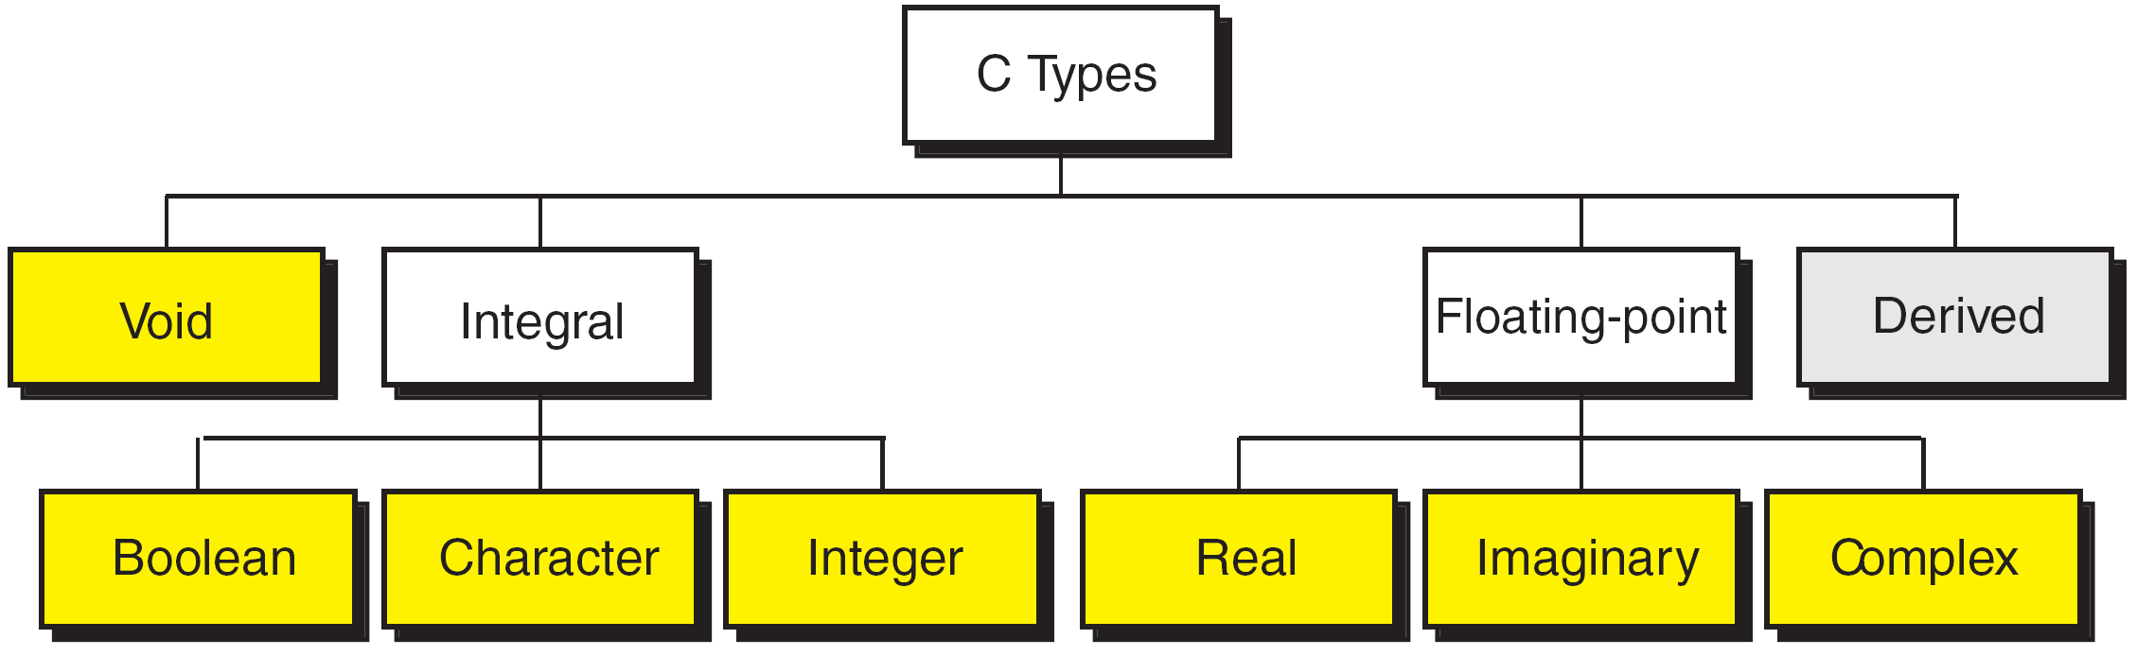
FIGURE 2-7 Data Types

Slide 19
FIGURE 2-8 Character Types
Notes:
wchar_t is a wide character: The increased datatype size allows for the use of larger coded character sets. Width is compiler specific (not portable).

Slide 20
FIGURE 2-9 Integer Types

Slide 21
Note
sizeof (short) ≤ sizeof (int) ≤ sizeof (long) ≤ sizeof (long long)

Slide 22
Table 2-3
Typical Integer Sizes and Values for Signed Integers

Slide 23
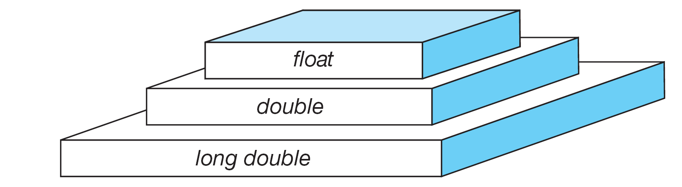
FIGURE 2-10 Floating-point Types

Slide 24
Note
sizeof (float) ≤ sizeof (double) ≤ sizeof (long double)

Slide 25
Table 2-4
Type Summary

Slide 26
2-5 Variables
Variables are named memory locations that have a type, such as integer or character, which is inherited from their type. The type determines the values that a variable may contain and the operations that may be used with its values.
Topics discussed in this section:
Variable Declaration
Variable Initialization

Slide 27
FIGURE 2-11 Variables

Slide 28
Table 2-5
Examples of Variable Declarations and Definitions

Slide 29
‘B’
FIGURE 2-12 Variable Initialization

Slide 30
Note
When a variable is defined, it is not initialized. We must initialize any variable requiring prescribed data when the function starts.

Slide 31
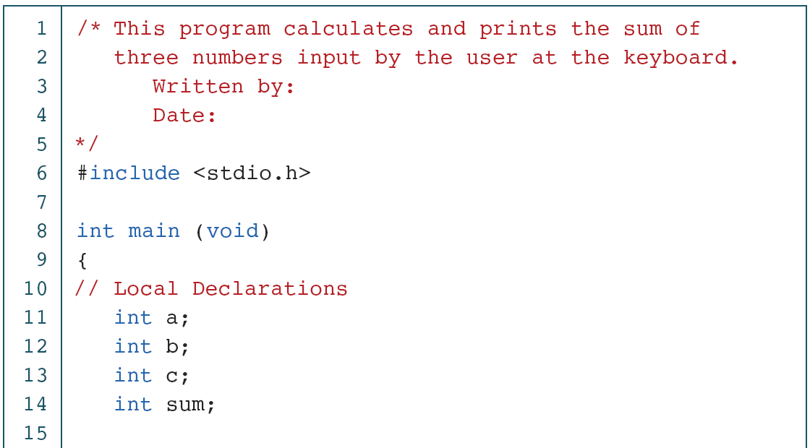
PROGRAM 2-2
Print Sum of Three Numbers

Slide 32
PROGRAM 2-2
Print Sum of Three Numbers (continued)

Slide 33
PROGRAM 2-2
Print Sum of Three Numbers (continued)

Slide 34
2-6 Constants
Constants are data values that cannot be changed during the execution of a program. Like variables, constants have a type. In this section, we discuss Boolean, character, integer, real, complex, and string constants.
Topics discussed in this section:
Constant Representation
Coding Constants

Slide 35
Note
A character constant is enclosed in single quotes.

Slide 36
Table 2-6
Symbolic Names for Control Characters

Slide 37
Table 2-7
Examples of Integer Constants

Slide 38
Table 2-8
Examples of Real Constants

Slide 39
FIGURE 2-13 Some Strings

Slide 40
FIGURE 2-14 Null Characters and Null Strings

Slide 41
Note
Use single quotes for character constants. Use double quotes for string constants.

Slide 42
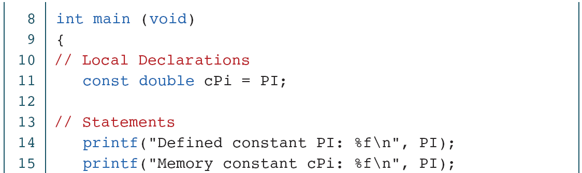
PROGRAM 2-3
Memory Constants

Slide 43
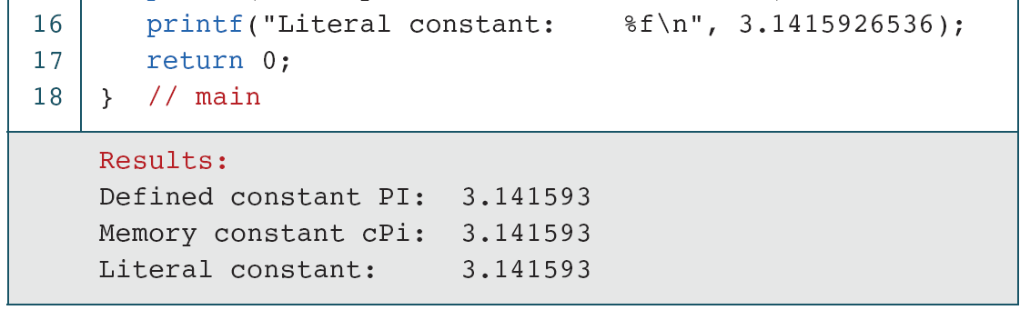
PROGRAM 2-3
Memory Constants (continued)

Slide 44
Operators in C

Slide 45
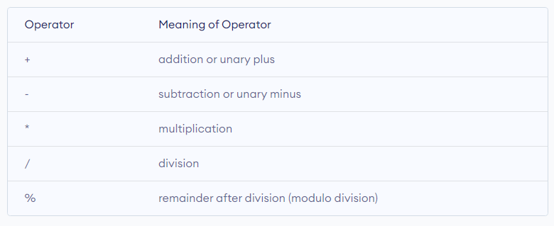
An operator is a symbol that operates on a value or a variable. For example: + is an operator to perform addition.
Table 2-6
C Arithmetic Operators

Slide 46
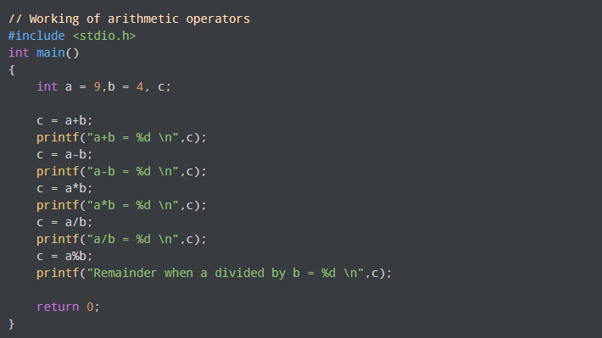
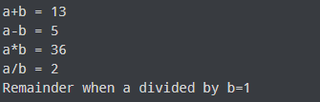
PROGRAM 2-3
Operators in C

Slide 47
Increment and Decrement Operators
C programming has two operators increment ++ and decrement -- to change the value of an operand (constant or variable) by 1.
Increment ++ increases the value by 1 whereas decrement -- decreases the value by 1. These two operators are unary operators, meaning they only operate on a single operand.

Slide 48
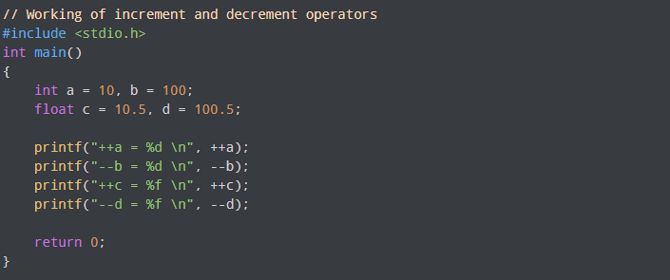
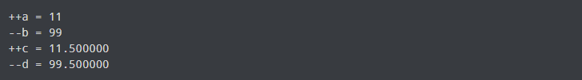
PROGRAM 2-3
Operators in C
Output

Slide 49
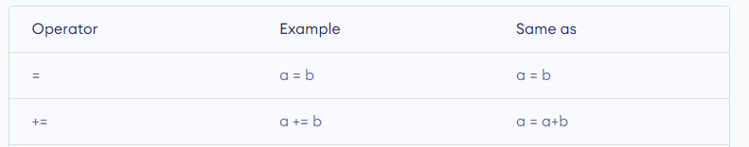
C Assignment Operators
An assignment operator is used for assigning a value to a variable. The most common assignment operator is =

Slide 50
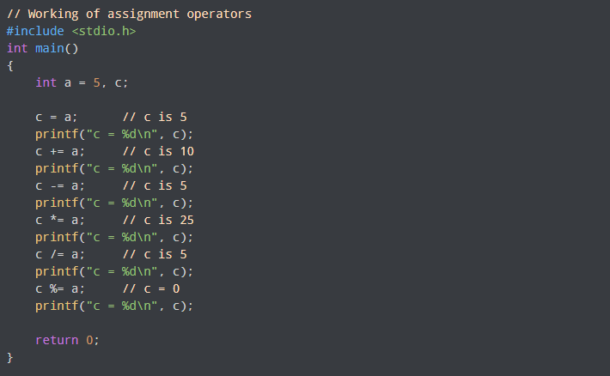
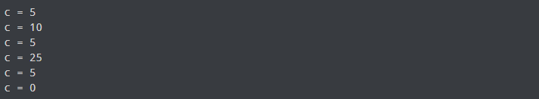
PROGRAM 2-3
Operators in C
Output

Slide 51
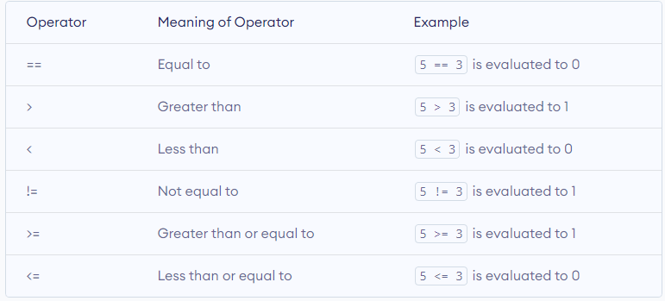
C Relational Operators
A relational operator checks the relationship between two operands. If the relation is true, it returns 1; if the relation is false, it returns value 0.
Relational operators are used in decision making and loops.

Slide 52
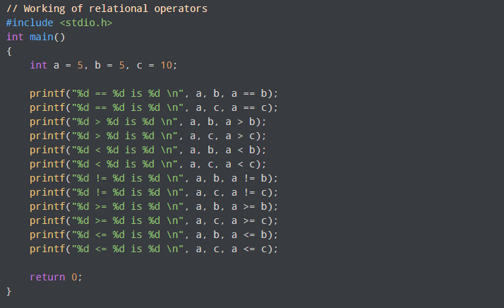
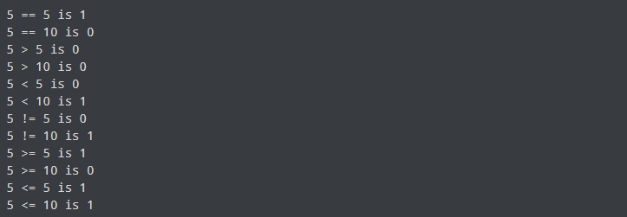
PROGRAM 2-3
Operators in C
Output

Slide 53
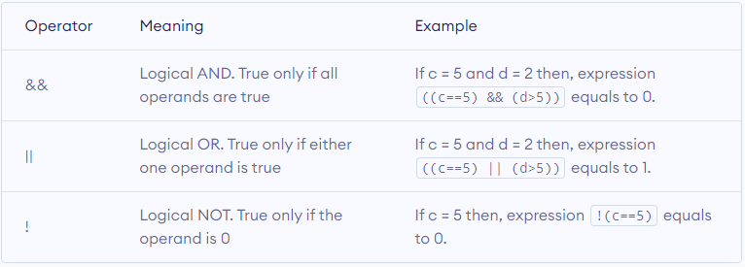
C Logical Operators
An expression containing logical operator returns either 0 or 1 depending upon whether expression results true or false. Logical operators are commonly used in decision making in C programming.

Slide 54
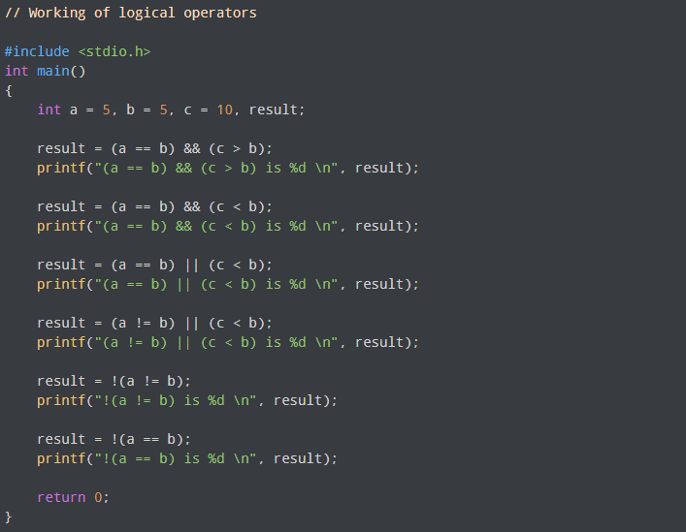
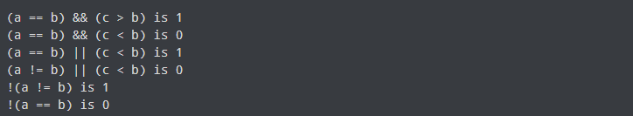
PROGRAM 2-3
Operators in C
Output

